Slide 1


Optimization in Space Flight Mechanics
Amber Scarbrough, Dr. Davide Conte
Embry-Riddle Aeronautical University
Dr. Anne Boettcher
2021 Arizona Space Grant Symposium

Slide 2
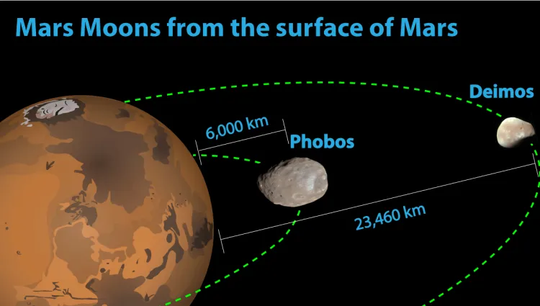
Problem Statement
Source: https://inventionsky.com/mars-moons-phobos-and-deimos/

Slide 3
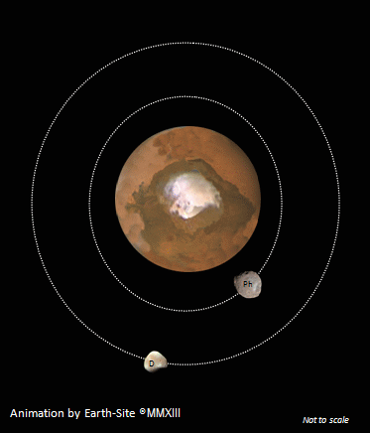
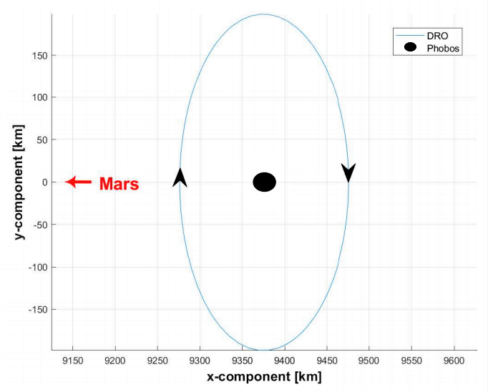
The Problem of Interest
Source: http://www.earth-site.co.uk/Education/martian-moons/

Slide 4
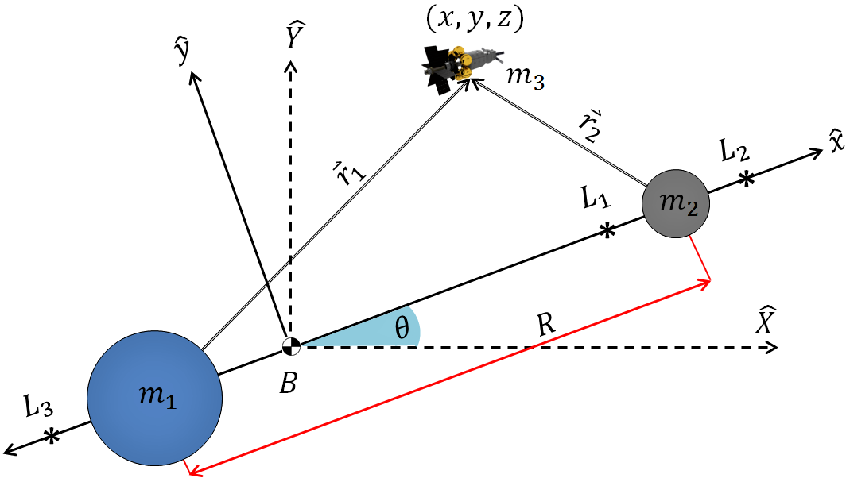
Objectives
Source: Source: Conte, D., Spencer, D., "Mission analysis for Earth to Mars-Phobos distant Retrograde Orbits", Acta Astronautica, 2018.

Slide 5
Methods - Optimization
Based on the behavioral patterns of swarms of bees in a field trying to locate an area of the highest density of flowers.

Slide 6
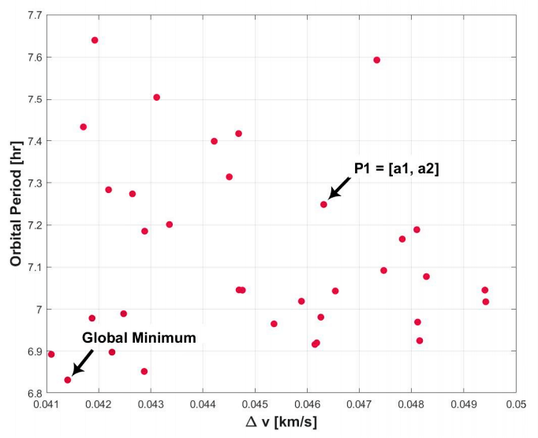
PSO Algorithm

Slide 7
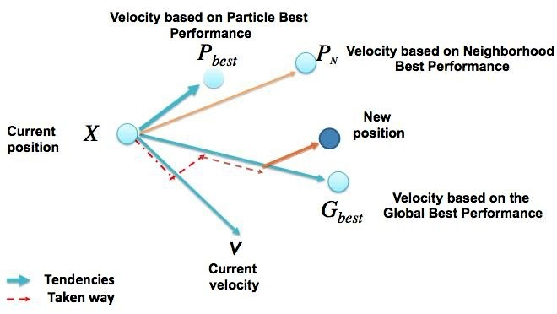
Methods - PSO
Source: Zemzami, M., "An Evolutionary Hybrid Algorithm for Complex Optimization Problems," 2019.

Slide 8
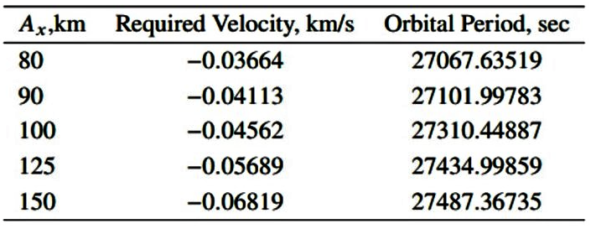

Results
Global best solutions for the desired amplitude of the new orbit, $A_{x}$.

Slide 9
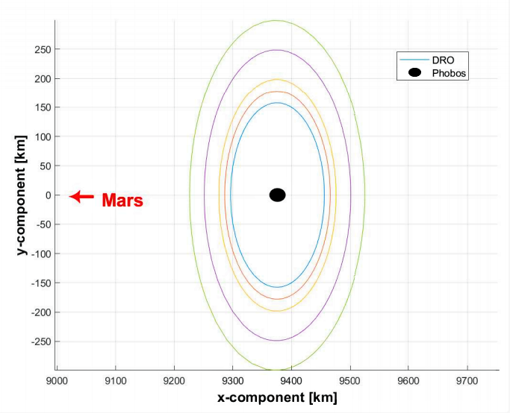
Interpretation

Slide 10
Conclusion
Further work can be applied to include the original transfer orbit using backwards time integration.

